Slide 1

Diabetes Prediction System

Slide 2
Why Diabetes Prediction?
India: referred as ‘Diabetes Capital of the World’
Accounting: 17% of the total diabetes patients in the world
Estimate: Every 1 in 11 Indians is diagnosed with diabetes
Second most affected in the world, after China

Slide 3
Introduction
Based on training a model
Using some training data and testing against some testing data
Building efficient model to detect diabetic or not
Using various health parameters

Slide 4

Technology Used
Jupyter Notebook
Various Python Libraries:
NumPy
Pandas
Sklearn
Random Forest Classifier

Slide 5
Work Flow
New Data
Dataset
Data
Pre-processing
Random Forest Classifier
Train Test Split
Diabetic or Non-Diabetic Prediction
Random Forest Classifier

Slide 6
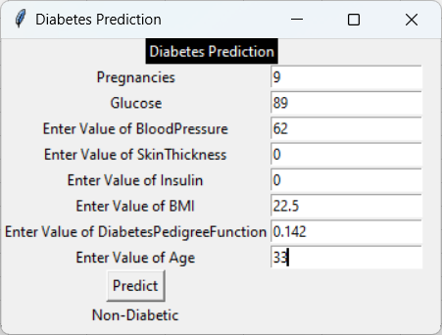
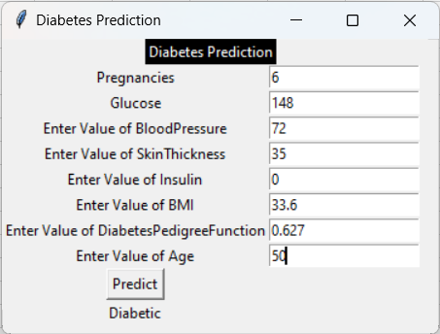
Outputs:

Slide 7

Thank You
By – Yogesh Kumar Bhatt

